Slide 1







Software University: Learning Program
Become a Software Engineer and Start a Job
SoftUni Team
Technical Trainers
Software University
https://softuni.bg

Slide 2
Table of Contents
Welcome to SoftUni
SoftUni Partners
SoftUni Trainers
Learning Paths and Opportunities

Slide 3
Questions?
sli.do
#fund-common

Slide 4
The SoftUni Family
Quality Digital Education for Thousands

Slide 5

Software Engineering Learning Program
The "Software University" learning program @ SoftUni
Become a professional software engineer in ~ 1-2 years
Professions:
C# / .NET Web Developer
Java & Spring Web Developer
JavaScript Web Developer
Python & Django Web Developer
Curriculum: https://softuni.bg/curriculum

Slide 6

SoftUni Partners
Tech Companies, Who Support SoftUni

Slide 7














SoftUni Diamond Partners

Slide 8

Educational Partners

Slide 9
Coca-Cola HBC – Bulgaria
Coca‑Cola HBC is one of the world's largest bottlers of brands from the Coca‑Cola company
CCHBC started operations in Bulgaria in 1992 and since then, is one of the biggest contributors to the local economy
Global company with over 36 thousand engaged people
CCHBC serves more than 715 million consumers across a broad geographic footprint of 29 countries on 3 continents
https://bg.coca-colahellenic.com

Slide 10

Ambitioned
Offering digital transformation by delivering high-quality software solutions
Expertise in eLearning development
Business analysis, architecture, development, support, cloud deployment, integration, scalability, security, and more
Building an infrastructure for data aggregation, analysis, and reporting
Core expertise in .NET technologies
https://ambitioned.com/

Slide 11

CreateX
Site design
Website optimization – SEO
Online advertising – PPC
Social media marketing
Copywriting
Creative concept and design
https://createx.bg/

Slide 12

Postbank
One of the top banking institutions in Bulgaria
Employer of the year for 2017
Member of the Eurobank Group with € 58 billion of assets
Serious investments in digitization
The first bank credit botchat – EVA
https://www.facebook.com/evapostbank
https://www.postbank.bg/Za-nas/Careers

Slide 13
SuperHosting
The largest hosting company in Bulgaria
Hosting & Domains
WordPress Hosting
VPS Servers
SSL Certificates
E-Commerce
Top-quality support
Top-qualified team
Offering a complete solution
Leading technical equipment
https://www.superhosting.bg/

Slide 14
SmartIT
Established in 2005
Developing their own Fintech software tools
Technological hub of MFG with a focus to establish a new generation platform Smart Check
Using C#, .Net Core, Web API, RabbitMQ, Microservices, Docker, Kubernetes, Polymer, React, JS, JQuery, MS SQL, MongoDB, etc
Looking for Devs & QAs
https://www.smartit.bg

Slide 15
Draft Kings
US-based award-winning tech company
Has a team of over 3900 talented engineers across the globe
Works with innovative technologies to deliver high-quality sports entertainment products to their clients
DraftKings has more than 1000 employees in Bulgaria, with offices in Sofia and Plovdiv
https://careers.draftkings.com/jobs/

Slide 16

Indeavr
Business and technology services company
Business application development
Cloud engineering services
Collaboration services
Looking for junior .NET Developers
https://www.indeavr.com/en/careers

Slide 17



Software Group
Integration solutions for financial institutions
Provide digital transformation
https://www.softwaregroup.com/
Discovering Potential
Driving Innovation
Unlocking Opportunities

Slide 18

Schwarz IT
Digital heartbeat of the leading global retail group Schwarz
The group brings together Lidl and Kaufland retail chains, the recycling company Pre Zero, and the manufacturing company Schwarz Production
500,000 employees worldwide & over 12,900 stores in more than 30 countries
Provision of IT infrastructure, platforms, and business applications
Long-term commitment to support education and invest in the development of business and IT professionals
https://it.schwarz/en/it-hubs/bulgaria

Slide 19

PokerStars
Product company home of PokerStars, PokerStars Casino and PokerStars Sport
Part of the International division of Flutter Entertainment Plc., a global sports betting and gaming operator
Global engineering team, industry-leading products - innovative Sportsbook platform, a renown poker site, and the world's fastest-growing casino
Java, JS, React, Kubernetes, AWS, and many more
https://pokerstarscareers.com/

Slide 20

PharVision Capital
Founded in 2020 in Chicago
Provide superior uncorrelated investments returns using statistics and AI/ML methods
Sources un/structured datasets, sound economic and financial principles, and advanced ML techniques to capture in the equity markets
https://www.pharvision.ai/

Slide 21

Bosch.IO
Bosch.IO drives the digital and AIoT business of Bosch Group
Five countries and 900 associates, more than 200 of whom are working in the Bulgarian office
Languages and frameworks: Java, Spring Boot, Go, TypeScript; Mobile: iOS & Android; Cloud Platforms: Azure & Azure DevOps, AWS
Looking for software engineer / architect, cloud engineer, UX/UI designer, project manager, product / business owner
https://bosch.io/

Slide 22
DXC Technology
A Fortune 500 global IT services leader
Provides services for business process outsourcing, analytics and engineering, applications, security, cloud, IT outsourcing, and modern workplace
DXC has strong values, and fosters a culture of inclusion, belonging, and corporate citizenship
DXC is a virtual-first company, we put the employee experience first with a modern workplace and allow them to work from the comfort of their home
https://dxc.com/us/en

Slide 23

The Trainers
The Trainers for the Software Engineering Program

Slide 24

Veronika Vaneva
Former Training Director @ SoftUni
Product Owner @ Amusnet Interactive
Former Program Director @ Motion Software
Graduated from the Medical University - Pleven
Interests in Java, C++, and Unity

Slide 25
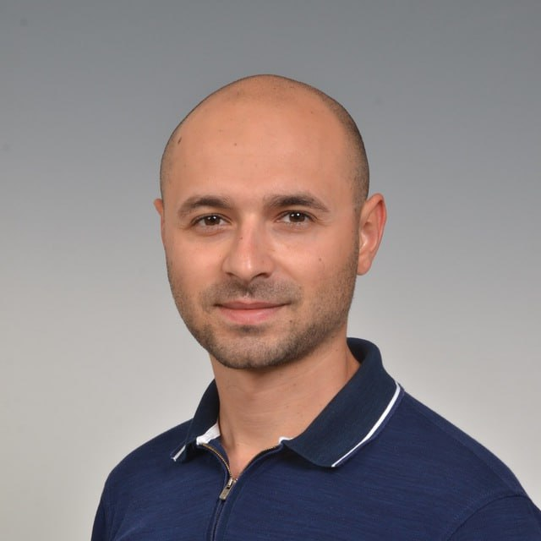
Stoyan Shopov
Senior Software Engineer @ Grand Games
Technical Тrainer @ SoftUni ~5 years
Microsoft Certified Trainer & Public Speaker
Experience with ASP.NET, Azure,
Unity and others

Slide 26
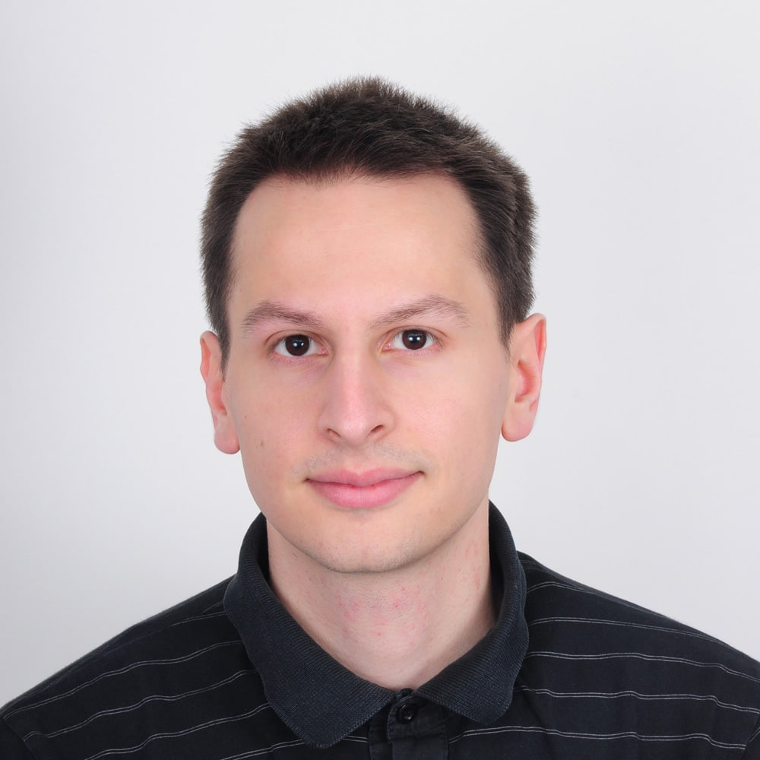
Viktor Kazakov
Worked on scalable high traffic distributed systems
Experience in JS, TS, Node.js, Angular, C#, ASP.NET MVC, Azure Cloud
Former Trainer @Software University
Former Full-stack Developer @Software University
Former Full-stack Developer @Developsoft

Slide 27
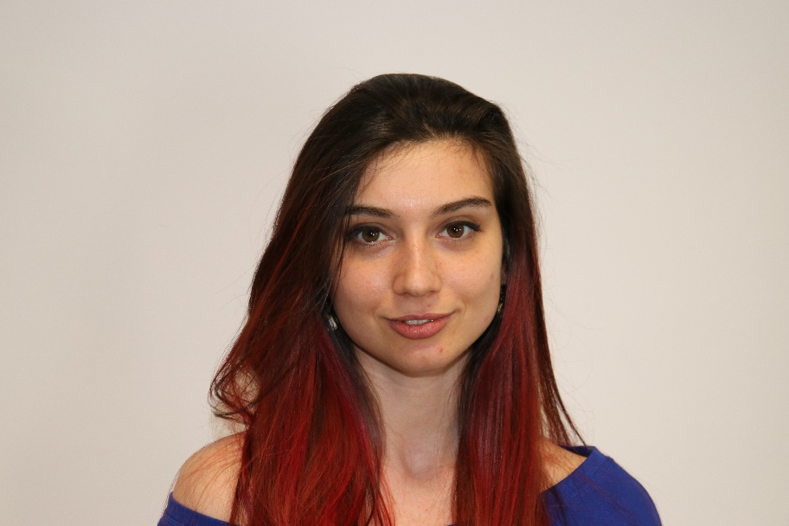
Ines Ivanova-Kenova
Senior Software Engineer at Nmible
Python, Django, Flask, FastAPI
C#, Angular
HTML, CSS
jQuery, Docker

Slide 28
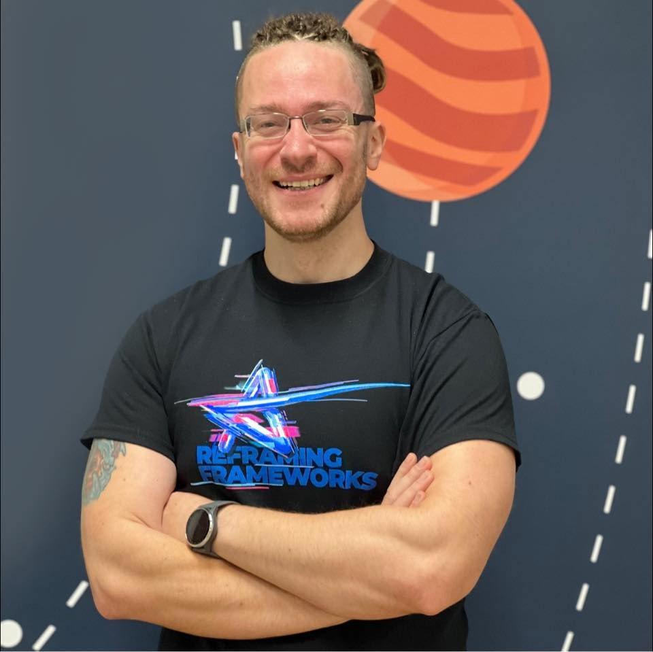
Ivaylo Kenov
CEO @ AMBITIONED
CTO @ SoftUni
Technical Trainer @ SoftUni
Creator of the most detailed software architecture course
Contacts:
https://github.com/ivaylokenov
https://linkedin.com/in/kenov

Slide 29
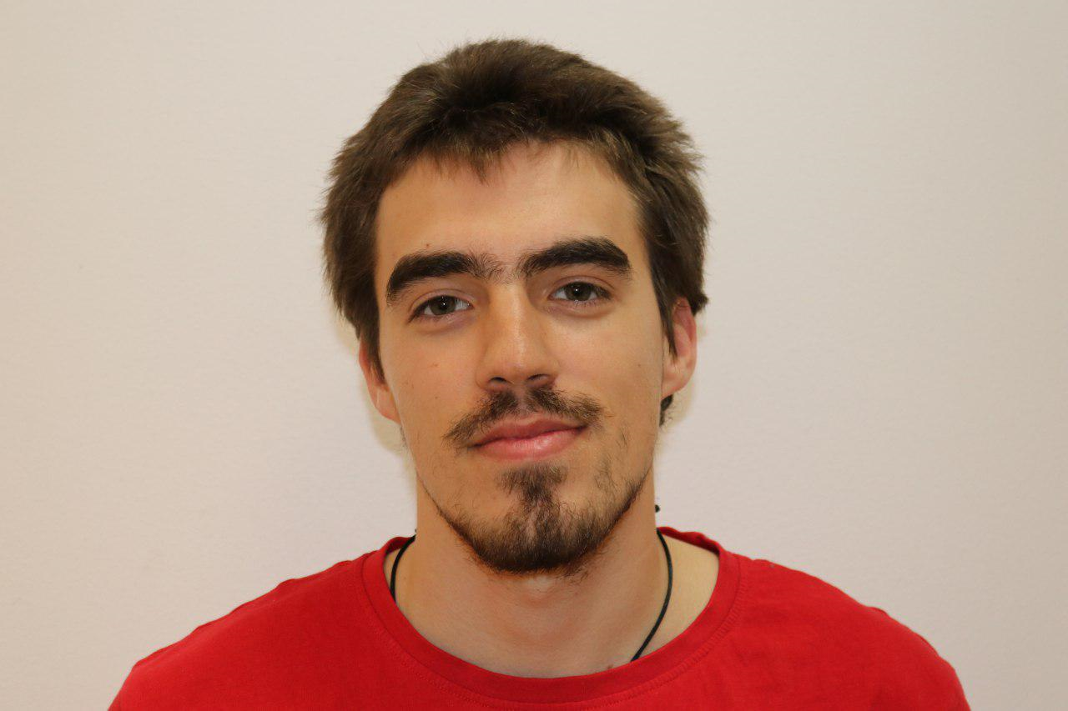
Nikolay Bankin
Software Engineer with many years of experience with various technologies
Teacher @ TUES
Many years of experience as a Trainer
Has worked with Scala, Akka, Java and JavaScript

Slide 30
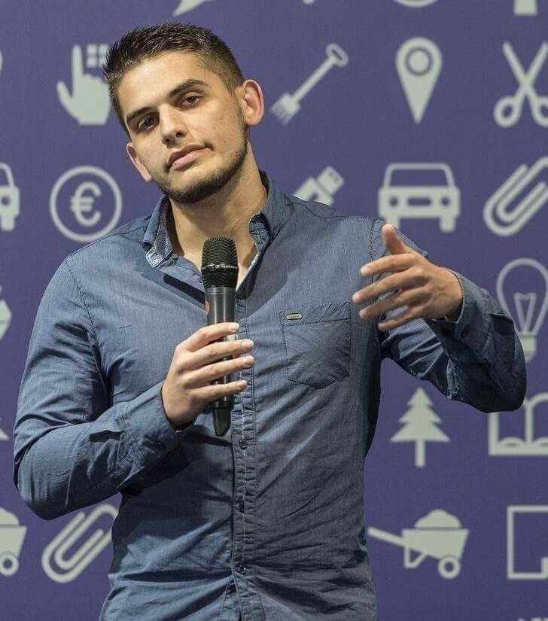
Viktor Dakov
Manager, Software Engineering @ Nuvolo
Worked at Amazon
John Atanasoff award
Participated in many programming contests
9+ Years of Experience as a Developer

Slide 31
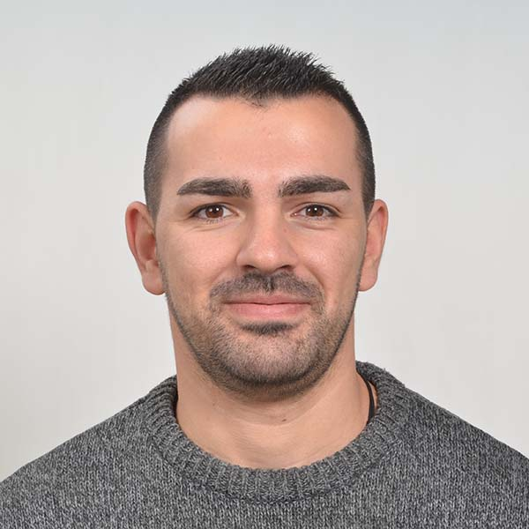
Mario Zahariev
Top student at SoftUni
Master of Cyber Security
4+ years of experience in Python
Interested in JavaScript, Artificial Intelligence and Go
Involved in researches related to artificial intelligence and machine learning

Slide 32
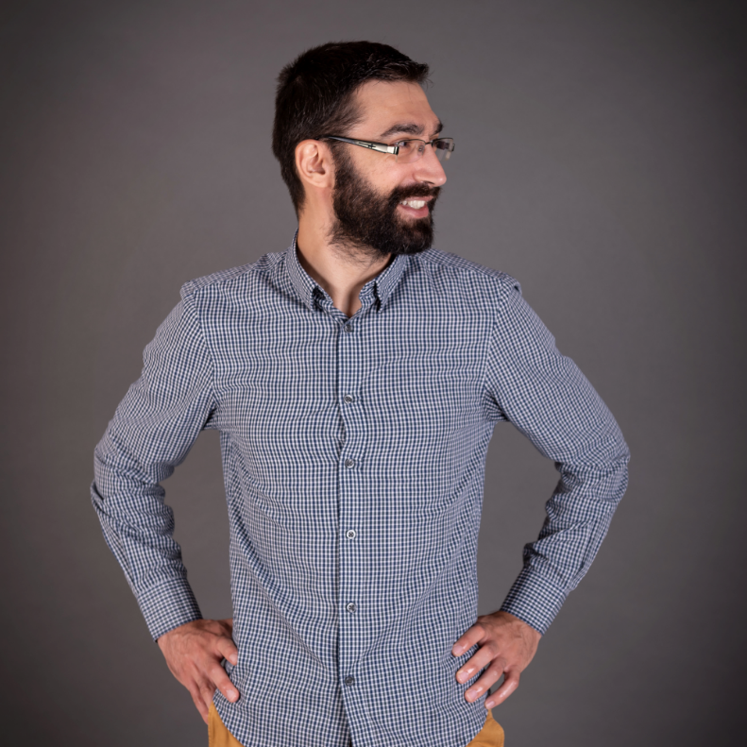
Viktor Kostadinov
Senior technical trainer with 6 years experience in the IT field
Front-End Instructor @ Amusnet Interactive
Former Head of the R&D Unit at Software University
Former Director of the Education Department
JavaScript enthusiast

Slide 33
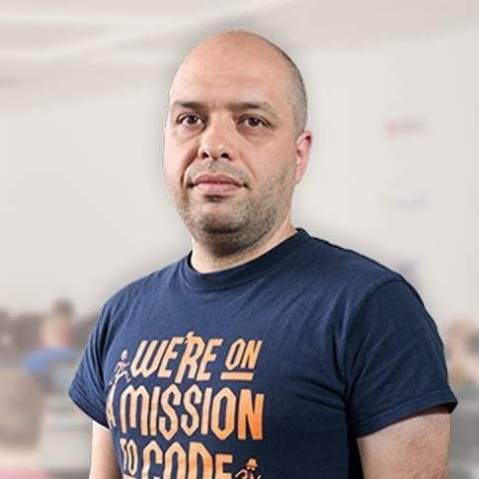
Stamo Petkov
Head оf Department @ Information Services Plc.
Worked with various technologies
.NET and C#, BASIC, Pascal, Object Pascal, PHP
20 years of experience
Experienced Lecturer
C# Basics and ASP.NET Core @ Softuni

Slide 34
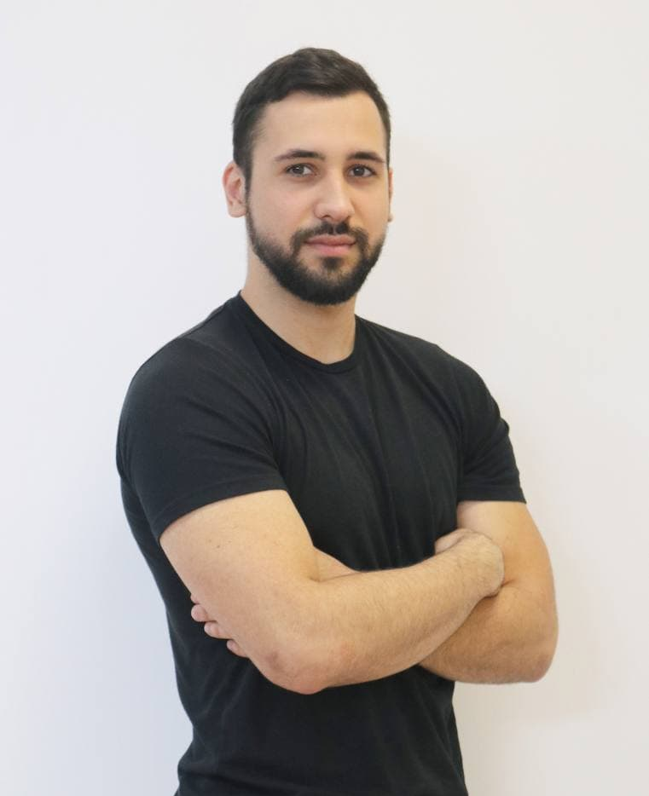
Nikolay Markov
Technical Trainer @ SoftUni
Java Developer @ Playtech Bulgaria
Top student @ SoftUni
Experience with Java, JavaScript, TypeScript and Angular
Plays basketball and billiard in his spare time
Interested in books, movies and comics

Slide 35
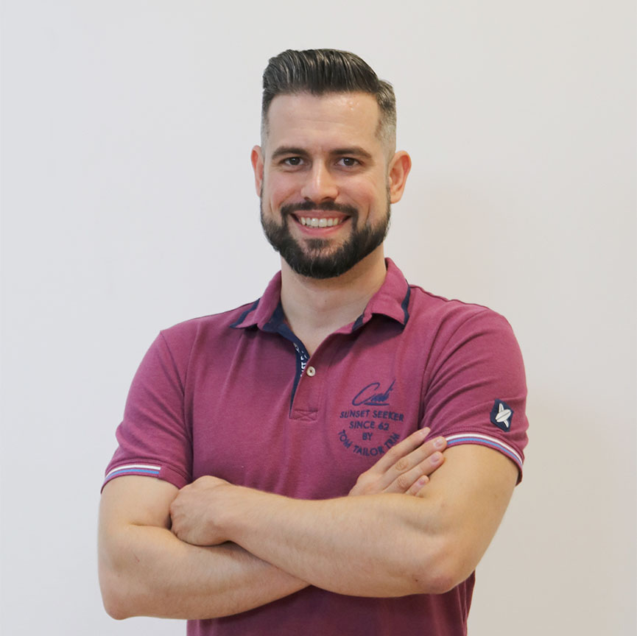
Ivaylo Papazov
Senior Software Engineer at Payhawk
Trainer at SoftUni
Experience with JS, React, Node.js, MongoDB
6+ years professional experience

Slide 36
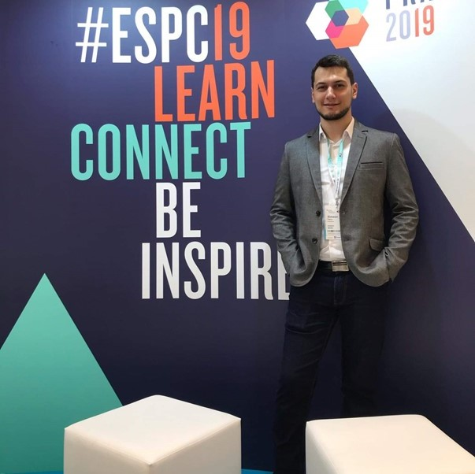
Simeon Petrov
Front-end Developer @ Blubito AG
Passionate about Vue, JavaScript & CSS
Experienced with Vue, React, Gatsby, Svelte, Angular
Getting involved more with NodeJS & Python

Slide 37
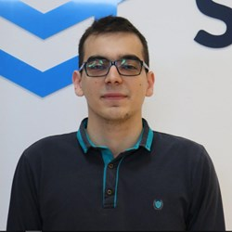
Kiril Kirilov
Software Consultant @Accedia
Technical Trainer @SoftUni for 3+ years
Passionate about both Back-End and Front-End Technologies
Experience with JS, .NET, ExpressJS, Angular, React and Vue.js

Slide 38

Learning Paths and Opportunities
The Choice is Yours

Slide 39
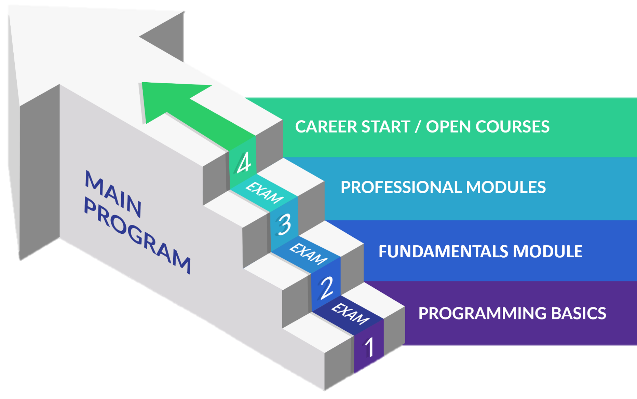
Software Engineering: Educational Program
Learning tracks: C#, Java, JavaScript, Python

Slide 40
Curriculum
Entry Module
Programming Basics
2 months
Fundamentals Module
Programming Fundamentals
4 months
Professional Modules
Java
C#
Python
JS
12-16 months
https://softuni.bg/trainings/courses

Slide 41
Questions?
Notes:
41

Slide 42
Trainings @ Software University (SoftUni)
Software University – High-Quality Education, Profession and Job for Software Developers
softuni.bg, about.softuni.bg
Software University Foundation
softuni.foundation
Software University @ Facebook
facebook.com/SoftwareUniversity
Software University Forums
forum.softuni.bg
Notes:
42

Slide 43

License
This course (slides, examples, demos, exercises, homework, documents, videos and other assets) is copyrighted content
Unauthorized copy, reproduction or use is illegal
© SoftUni – https://about.softuni.bg/
© Software University – https://softuni.bg
Notes:
43

